Slide 1
DMV Housing Analysis 2021-2023
Project 2
Group 7: Yonathan Shimelis, Sagar Shah, Dhwanil Mori, Fardin Hafiz

Slide 2

Background Overview
1. Housing prices in the U.S. have consistently risen over the years.
2. This trend has become a significant topic in today’s political discussions.
3. The focus of analysis is on its impact in the local DMV area.
4. Since 1992, housing prices have grown by an average of 4.2% annually.

Slide 3

Revisiting the Dataset
Key variables
ZHVI(home value), SizeRank, Metro, State
Data has been filtered based on specific zip codes.
The time range for the dataset spans from 2021 to 2023.

Slide 4

Smart Questions
What are the primary trends in housing prices over the past three years in [Selected State]? How does urban vs. rural areas compare in terms of price variation?
Can we quantify the rate of change in housing prices? What metrics can highlight housing affordability relative to median income in [Selected State]?
How does income (average income) impact the home values (ZHVI) in different years (2021-2023)?
How does the model's predictive accuracy improve with additional data (e.g., non-geographical variables)?

Slide 5
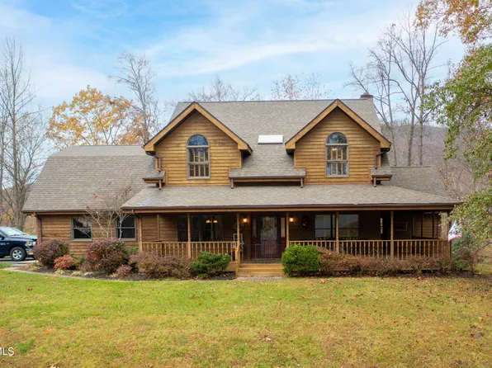
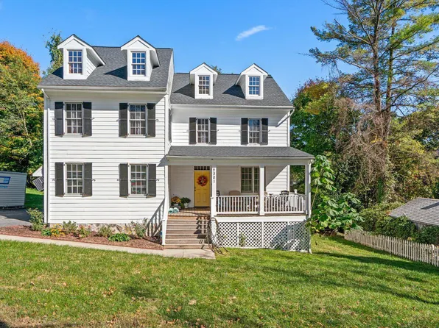
Initial Modeling
First model: Linear regression
Predictors: year, State, Metro, SizeRank
Target: Log(ZHVI)
Important steps:
Which variables/predictors to use
Understand the complexity of real housing data
No overfitting
Conclusion:
Data has shortcomings(variables)
Maybe linear regression isn’t the best for our data(?)

Slide 6
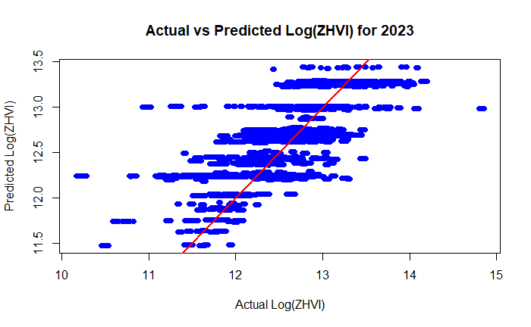
Results from testing simple linear model
Statistics:
MAE: 0.293
RMSE: 0.39
R-squared: 0.561

Slide 7


More modeling
Second Model: Random Forest
Goals:
To check for non-linear relationships between predictors and log(ZHVI)
Address shortcomings of the first linear model
Create a model better suited for more complex data
Conclusion:
Housing data is complex
Performed only slightly better than simple linear regression
0.594 vs 0.576 (r-squared)

Slide 8

Retrying Linear Regression
Key differences: # of households, avg household income
Goals:
Find non-geographical variables to improve model accuracy
Test if linear regression can work with our data
Conclusion:
Better r-squared (0.763 for both multiple/adjusted)
We still need other variables
Households is insignificant

Slide 9
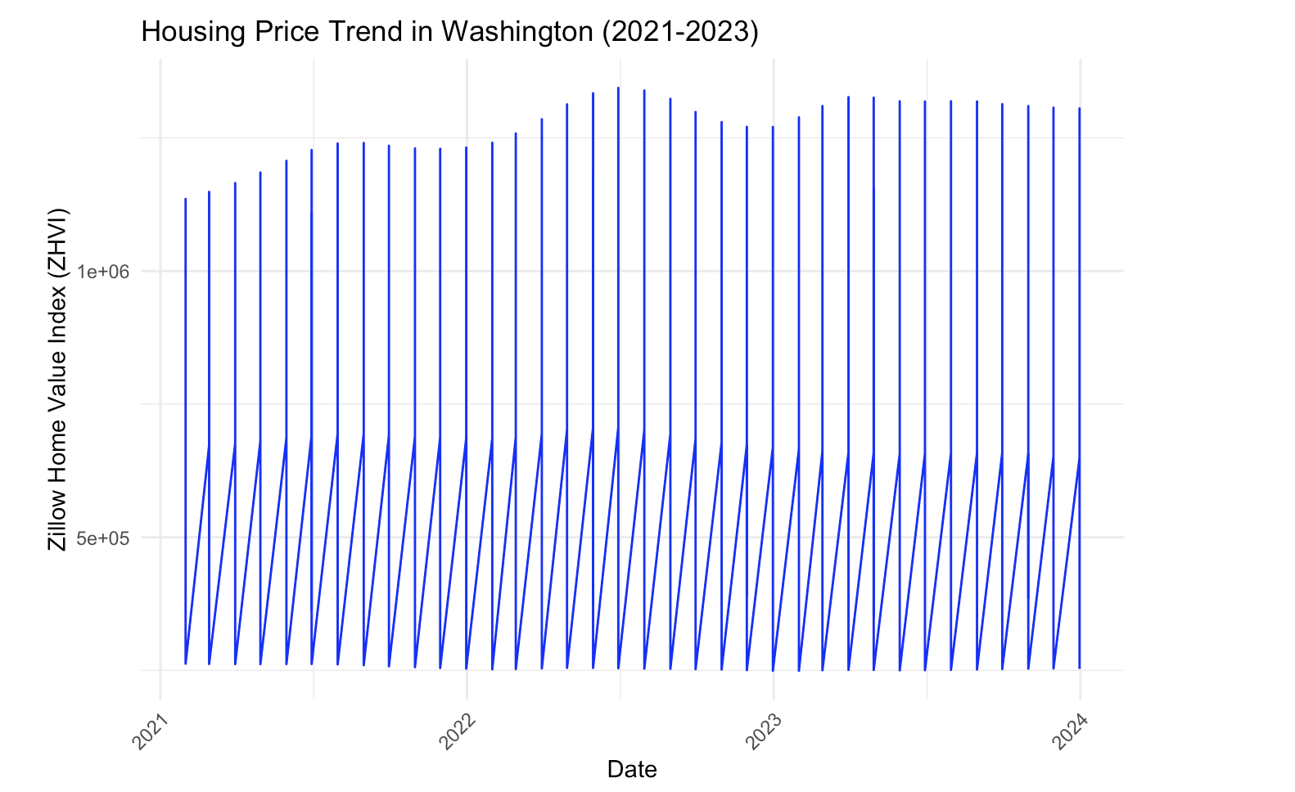
Smart Question 1

Slide 10
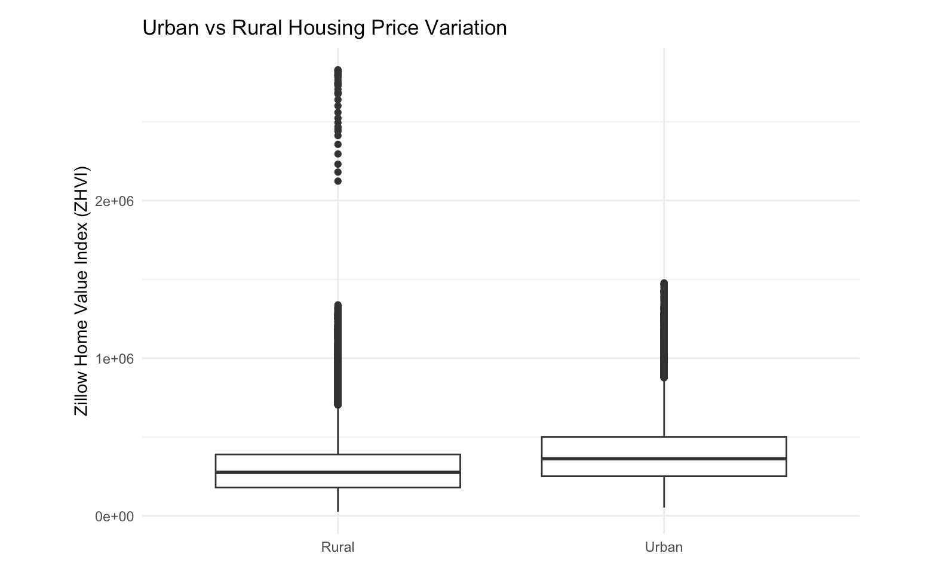

Slide 11
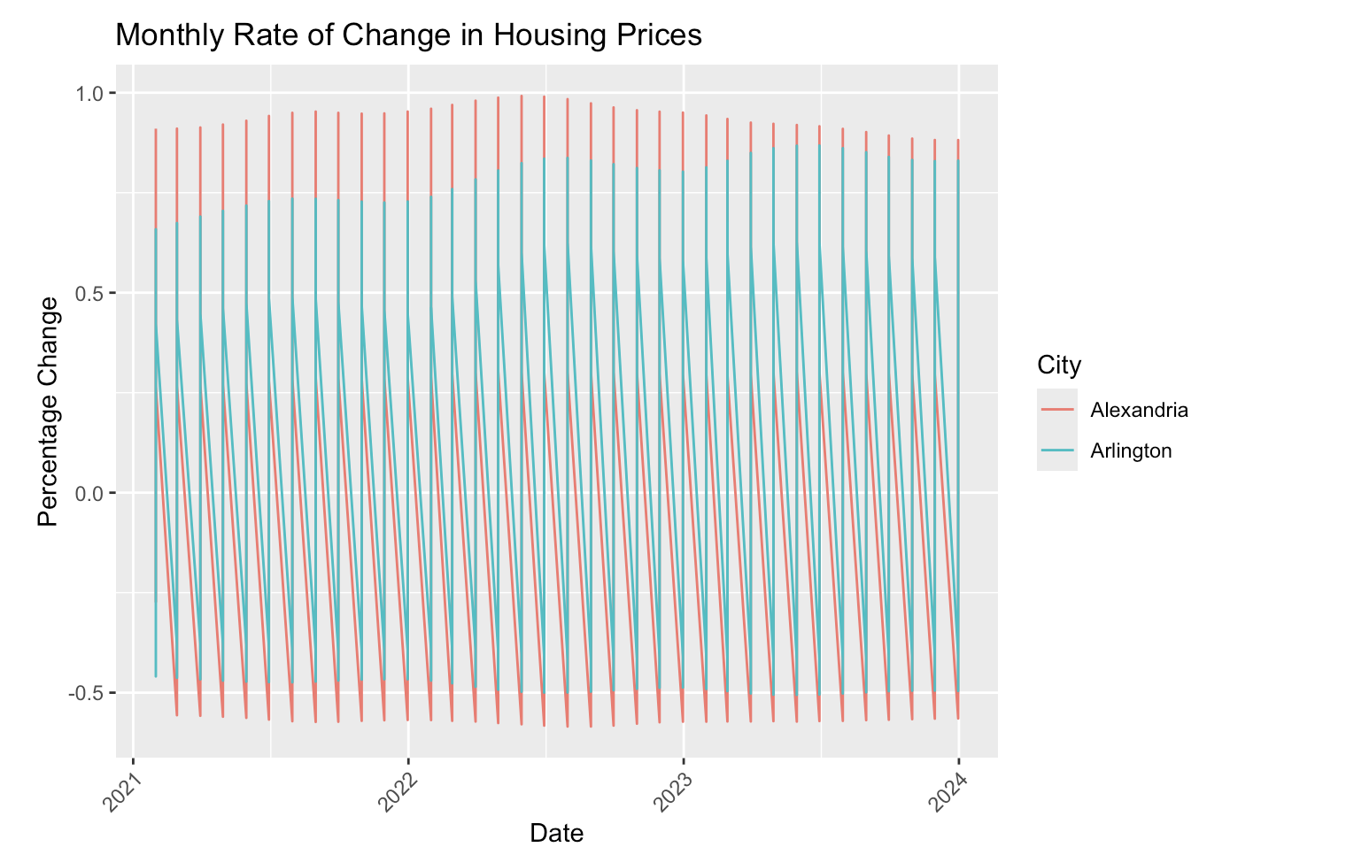
Smart Question 2

Slide 12
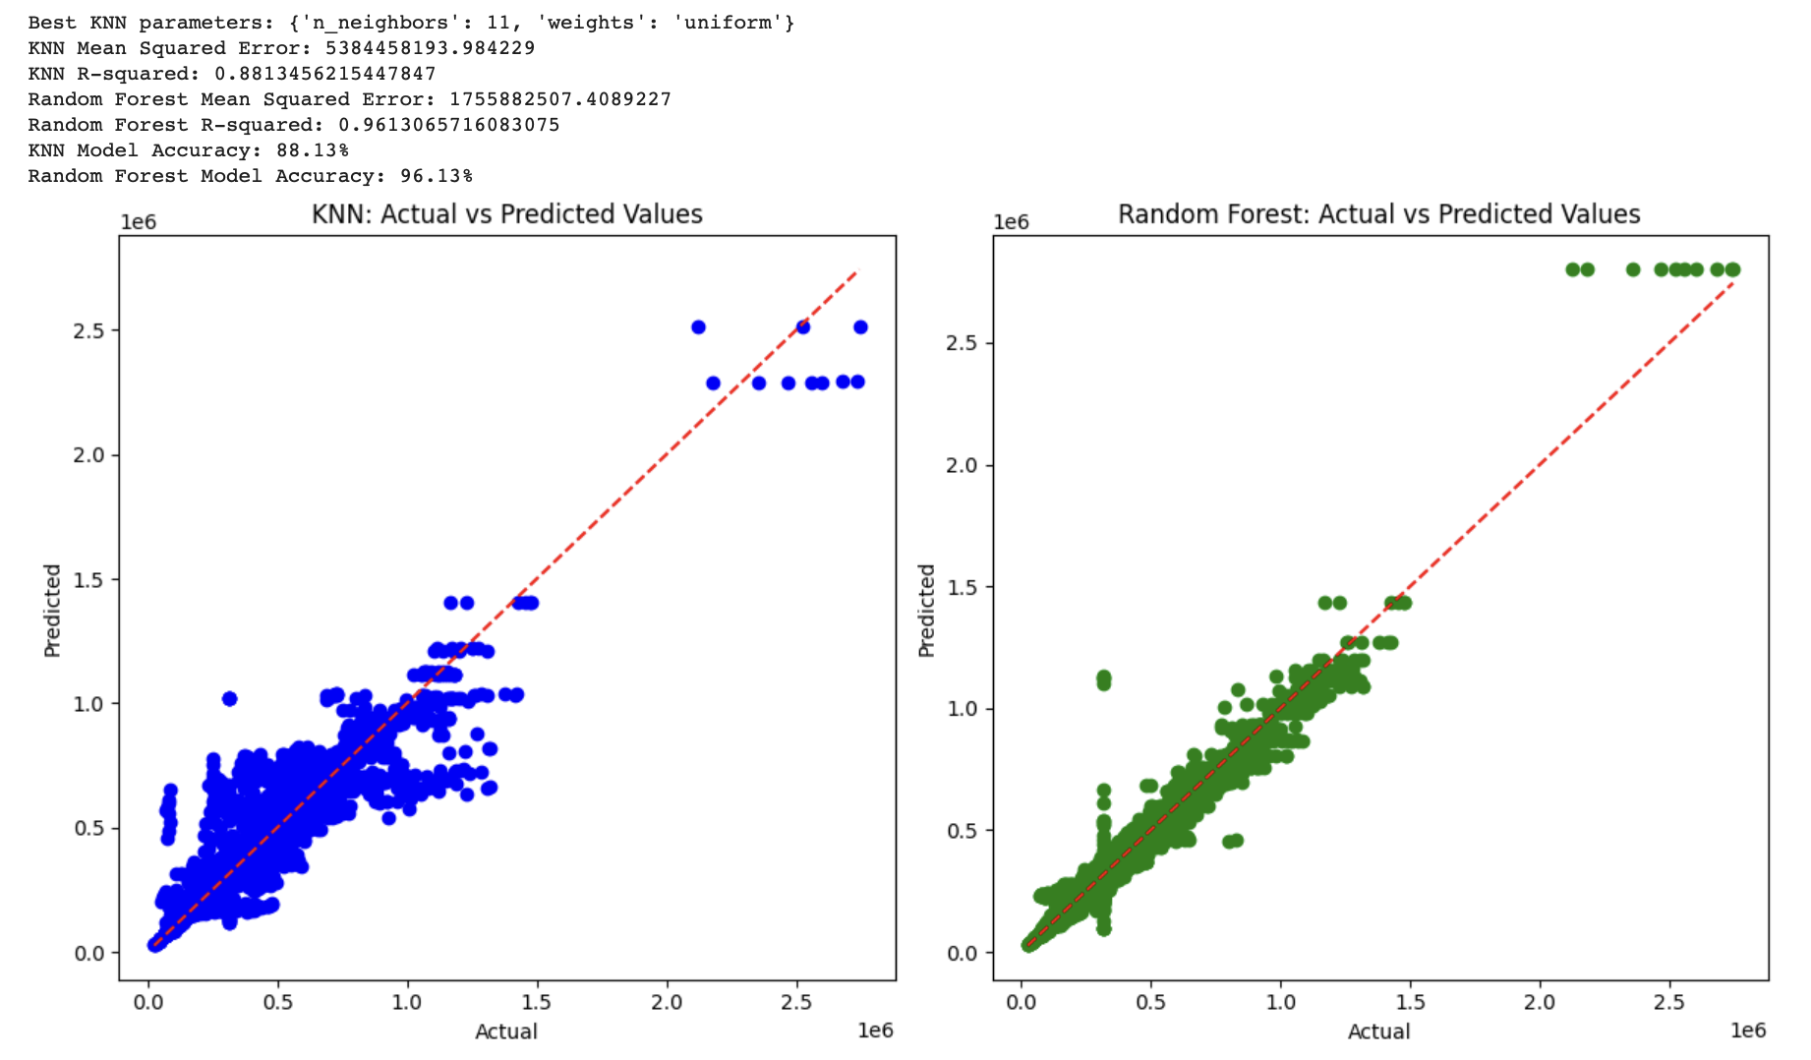
KNN vs Random Forest Generation

Slide 13
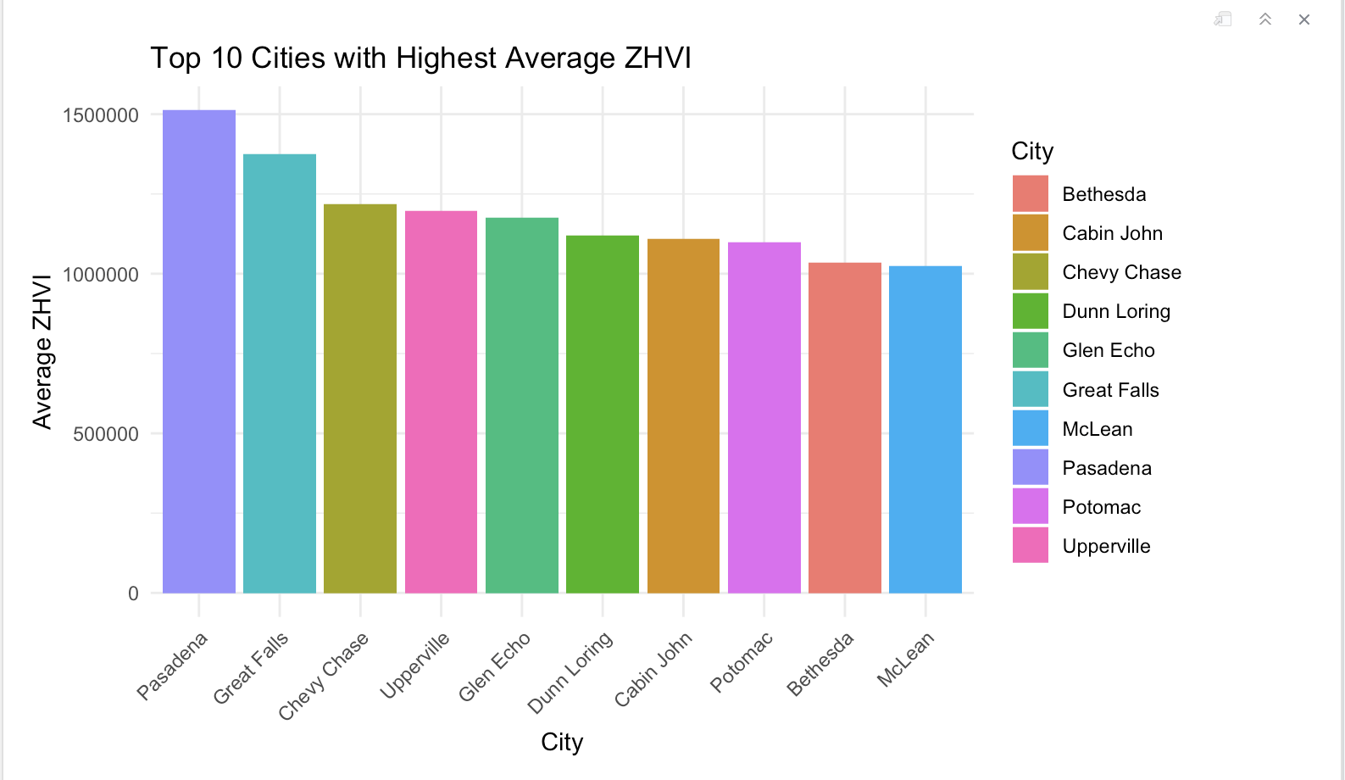
Smart Question 3

Slide 14
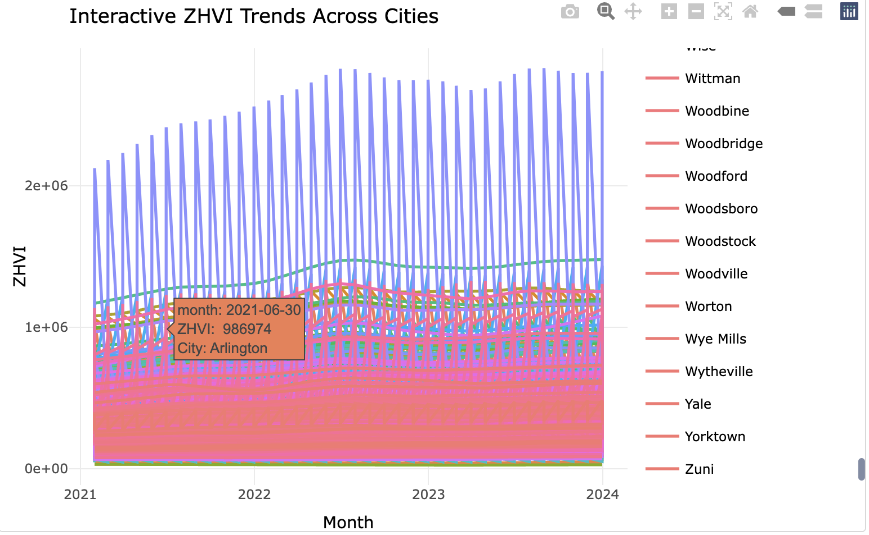

Slide 15
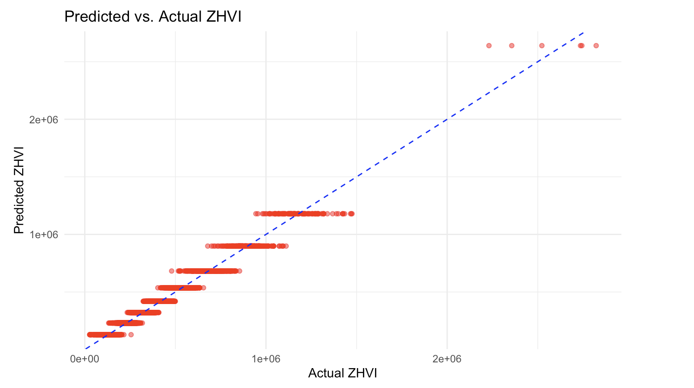
Trying Decision Tree Model

Slide 16

Further Modeling: Regression Trees
Goals:
To determine the role Sizerank of area has on determining the ZHVI of an area
Break down the Regression trees by area to gain a more concentrated understanding
Conclusions
Breaking down into Area is necessary to see variability
DC has the most variation in housing price, as seen by the more intricate tree

Slide 17
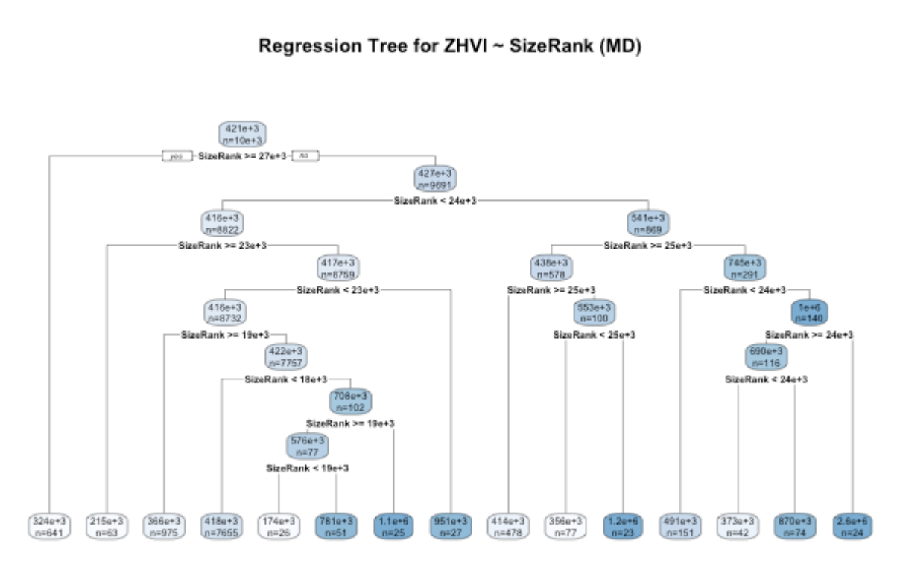
Regression Trees

Slide 18
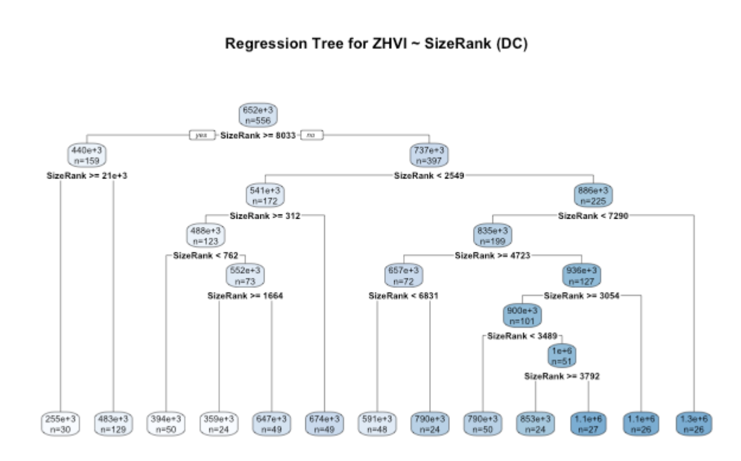

Slide 19
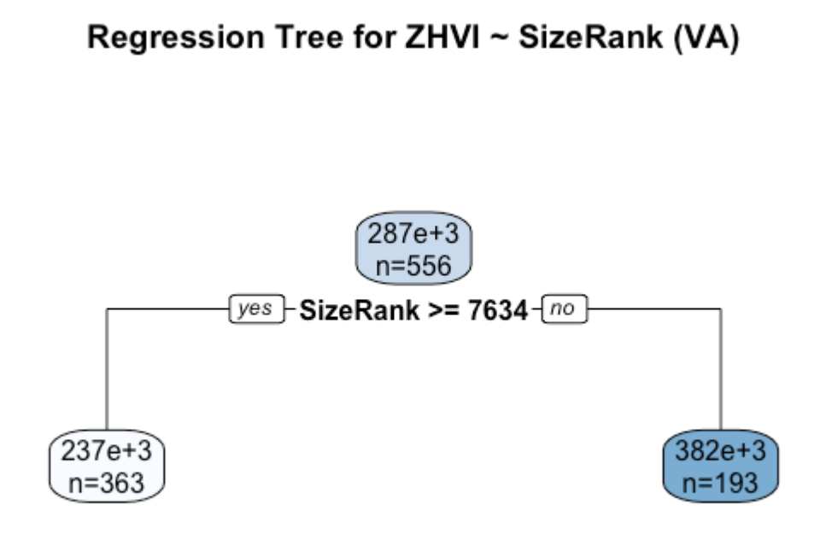

Slide 20
Conclusions
A multitude of different models were used to study which variables are important in determining ZHVI.
It can be seen that which variables are best at predicting ZHVI can vary between which area is being studied.
The general trends throughout each model seem to show the same concept, that general housing prices are increasing over all three states and that DC has the most expensive homes while VA has the least expensive in the areas studied.

Slide 21
Thank You Any Questions ?

